Slide 1


Open Education Analytics
a modern education data estate

Slide 2

Dispersed data prevents strategic use of data and AI
For the Use Cases You Need
Personalized Learning Pathways
Real Time Data Dashboards
Open Data for Research and Evaluation
Identifying and supporting at risk students
State, Province and National Longitudinal Reporting
Notes:
In most education systems today, you have different data sources in a lot of disconnected systems. Collecting that data and landing it in one place, where your teams can work with it efficiently and precisely, is really challenging with older data warehouse and data model approaches– If you could do this, however, it could enable many key education scenarios, from personalizing learning pathways; to real time reporting to schools, departments, educators, learners, and parents or guardians; to accelerating research and evaluation on programs and interventions. It could also unlock the power of AI and provide more efficient state and national longitudinal reporting. It all starts with setting up the modern data estate.

Slide 3













Data
Engineers
Data
Scientists
Contracted
Data Scientists
Learners,
Educators
School Leaders,
Researchers
Analysts
Personalized
Learning
Pathways
1) Authentication/Authorization
Azure Active Directory
Realtime Data Dashboards
On-premises data
2) Data Processing Tools
Open Data for
Research and Evaluation
Cloud data
Azure Synapse Analytics
SaaS data
State, Province and National Reporting
3) Storage
Azure Data Lake Storage
1) Collect
2) Compute
3) Communicate
Notes:
The modern data estate enables you to take all this disparate data and give your teams of data engineers, data scientists, and researchers the tools and access they need to do computing and analytics over this data, unlocking many types of education scenarios.
But there are a million technologies you could use to set up the modern data estate.
Even within Microsoft Azure you have a lot of choices.
Microsoft Education has developed Open Education Analytics, rooted in Azure Synapse, to provide a solution that simplifies and accelerates the learning analytics and AI journey, pulling together the best tools from across the landscape of modern analytics and AI services, to unlock the potential of key education scenarios.

Slide 4






Data
Engineers
Data
Scientists
Contracted
Data Scientists
Learners,
Educators
School Leaders,
Researchers
Analysts
v0.4
Personalized
Learning
Pathways
Ingest
Prep & Pseudo-nymize
Transform
& Enrich
Optimize
Build
& Train
Explore
Visualize
Package
& Deliver
On-prem data
Realtime Data Dashboards
Cloud data
Open Data for
Research and Eval
SaaS data
Cosmos
State, Province and National Reporting
stage 1
(bronze)
stage 2
(silver)
stage 3
(gold)
data subsets
SQL serverless
dedicated
SQL pool
1) Collect
2) Compute
3) Communicate
Notes:
With Open Education Analytics, we are providing a reference architecture for the Modern Data Estate, and a reference implementation that means you don’t have to build everything yourself. You can:
Provision and govern a modern data estate within your own Azure subscriptions,
Use Synapse studio to facilitate the process of data extraction, ingestion, preparation, transformation, and enrichment
Use Azure Active Directory to enforce role-based-access-control to the data for security and privacy,
Use powerful data visualization tools, such as Power BI, to explore and present data through flexible dashboards
Use modern data science tools, such as Auto ML, that enable high speed research over big data
All built on the foundation of Azure Data Lake storage, which means significant cost efficiencies.

Slide 5
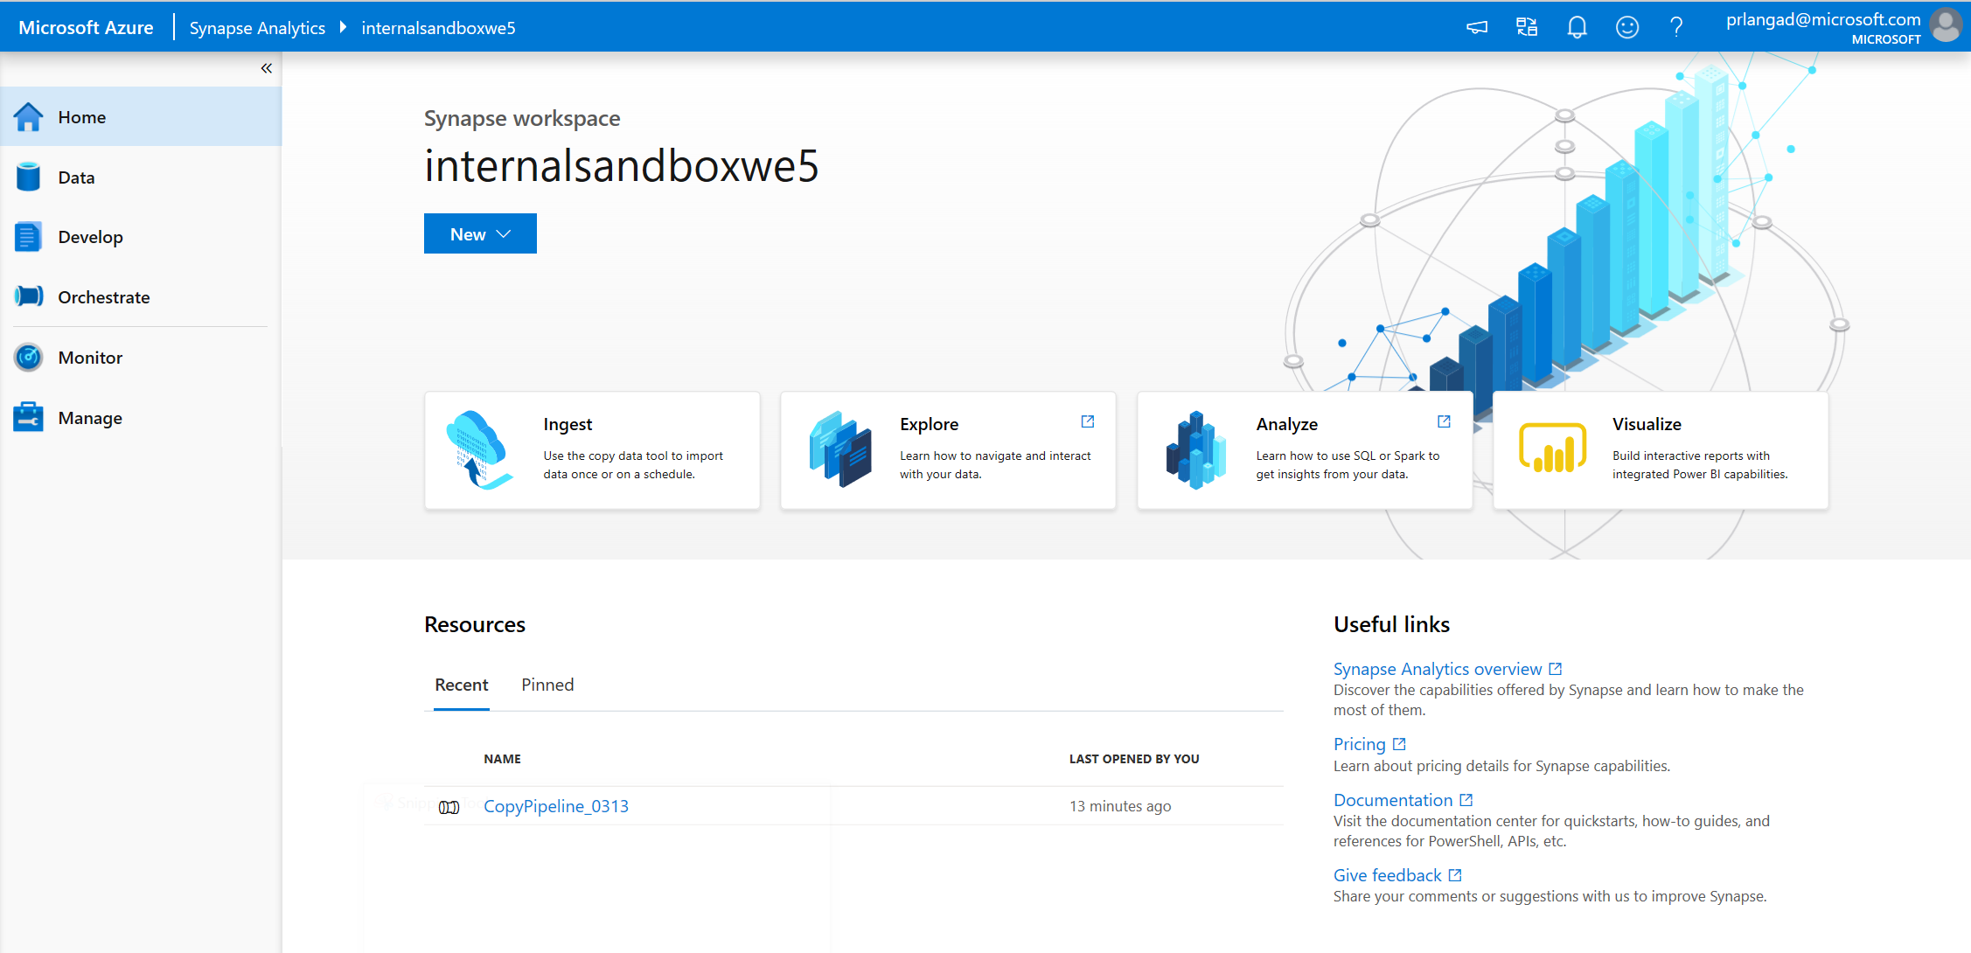
Studio
Azure Synapse Analytics > Studio > Overview
A single place for Data Engineers, Data Scientists, and IT Pros to collaborate on enterprise analytics

Slide 6


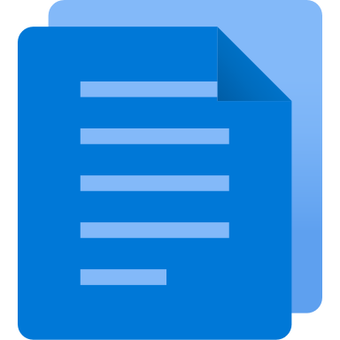



Synapse Studio
Azure Synapse Analytics > Studio > Overview
Synapse Studio divided into Activity hubs.
These organize the tasks needed for building analytics solution.
Overview
Data
Develop
Orchestrate
Quick-access to common gestures, most-recently used items, and links to tutorials and documentation.
Explore structured and unstructured data
Write code and the define business logic of the pipeline via notebooks, SQL scripts, Data flows, etc.
Design pipelines that that move and transform data.
Monitor
Manage
Centralized view of all resource usage and activities in the workspace.
Configure the workspace, pool, access to artifacts
Notes:
Alignment of activities

Slide 7
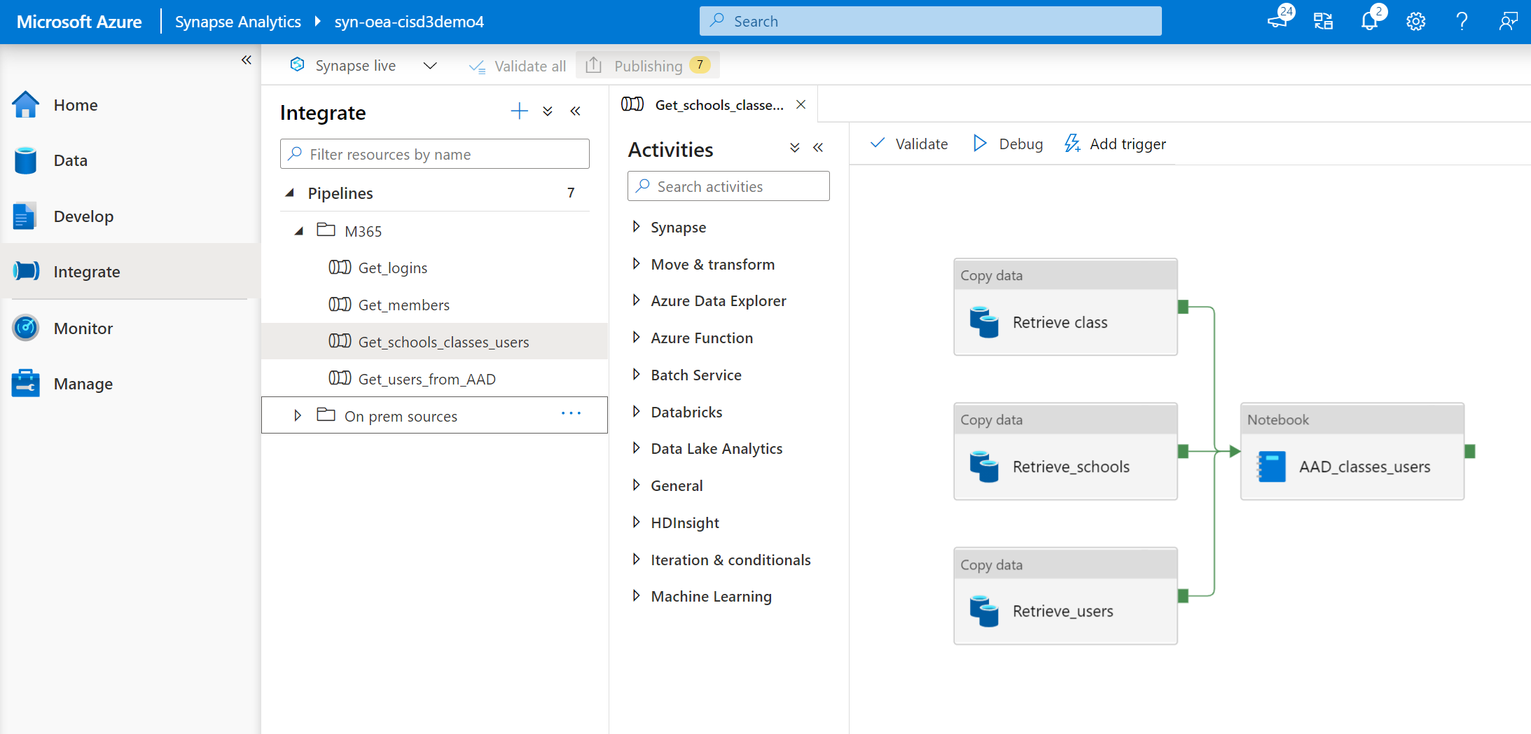
Ingest
On-prem data
Azure Data Factory
Cloud data
Azure Data
Share
SaaS data
stage 1
1) Collect
Notes:
The first stage is data collection, which is done through Azure Data Factory integration pipelines.
The goal is to extract data from the source system and land it in stage 1 of the data lake, in whatever format the source system provides it in.
For Microsoft source systems such as School Data Sync or any Azure Data Lake Storage, the Azure Data Share service can be used to easily land data and have it updated on a scheduled basis.
Azure Data Share is setup and managed via Azure portal.

Slide 8
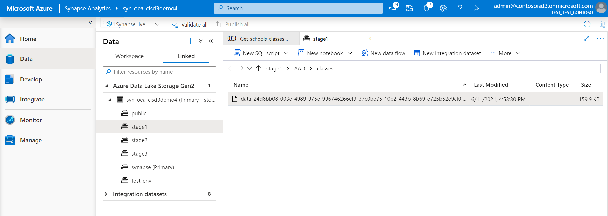
Ingest
On-prem data
Cloud data
SaaS data
stage 1
1) Collect

Slide 9
OEA Focus
standards
reusable assets/
best practices
rapid iteration/
emergent design
modern tech
ecosystem / global community
data standards (at rest, in transit)
process standards (ethical use, dev cycle, testing)
ethical use
ingestion pipelines, transformation scripts
dev process (dev cycle, testing strategy, releases)
training
sandbox env, test data sets
evolve schema
emphasis on build-learn-improve
cloud-based (low cost, infinitely scalable)
easy setup (setup scripts, infrastructure as code)
easy maintenance (auto-scale, monitoring)
easy to extend (extensible arch, add-on modules)
customers, SI’s, ISV’s, standards bodies, policymakers
focus on sharing, collaboration

Slide 10
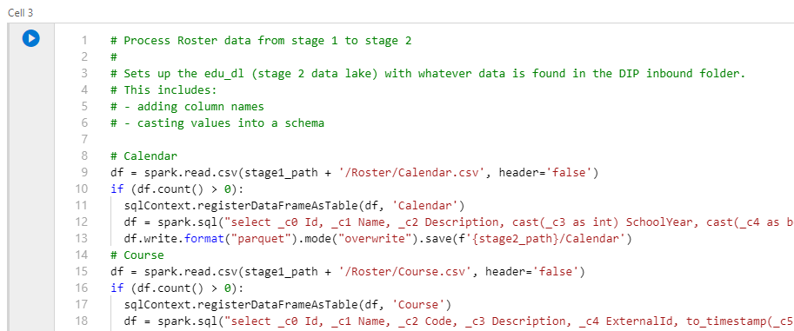
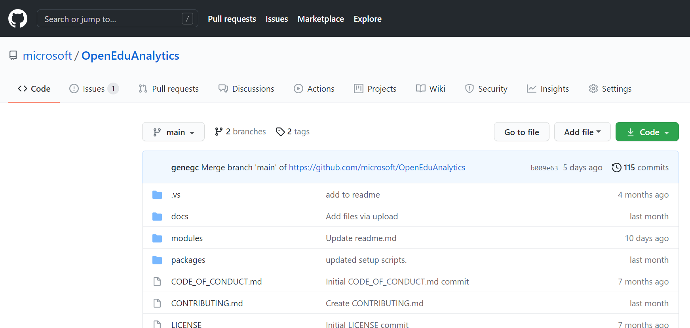
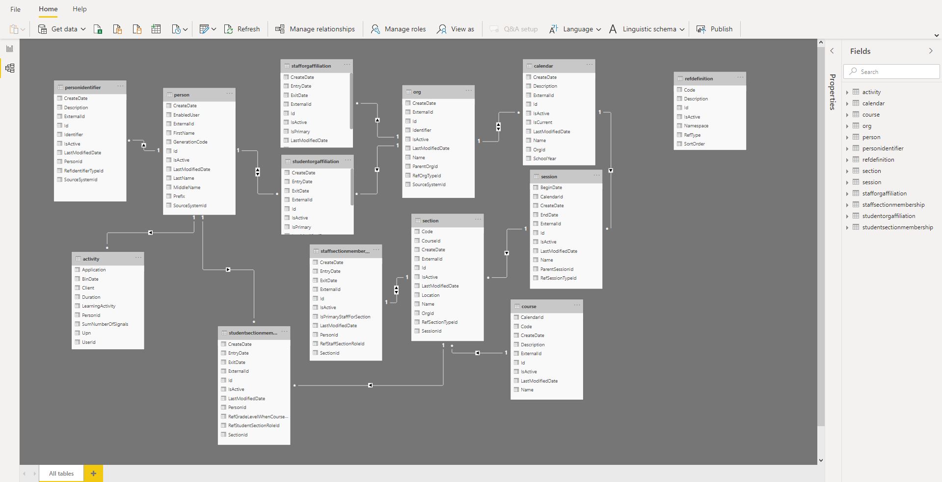
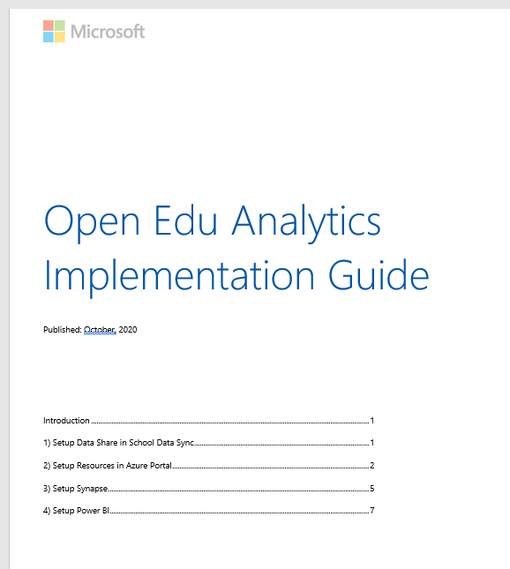
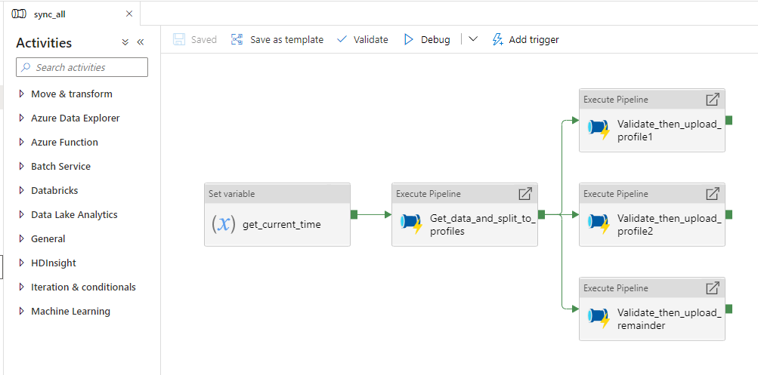
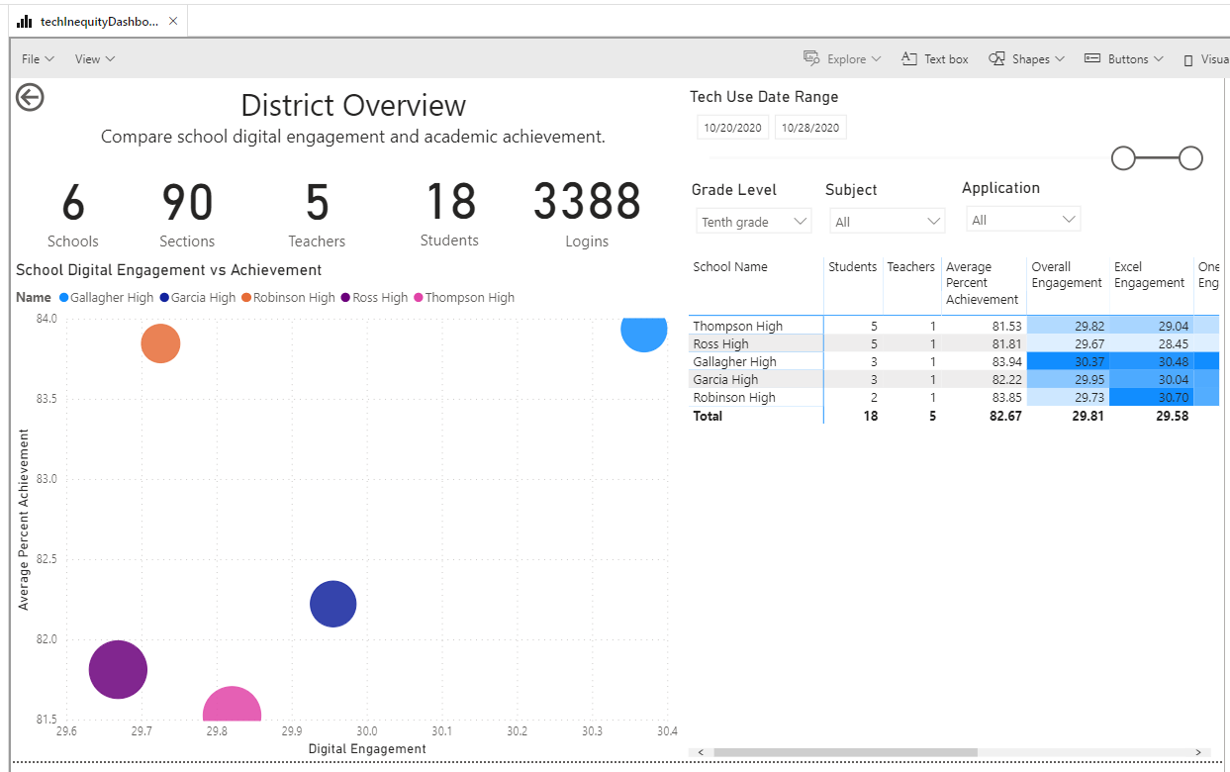

Slide 11
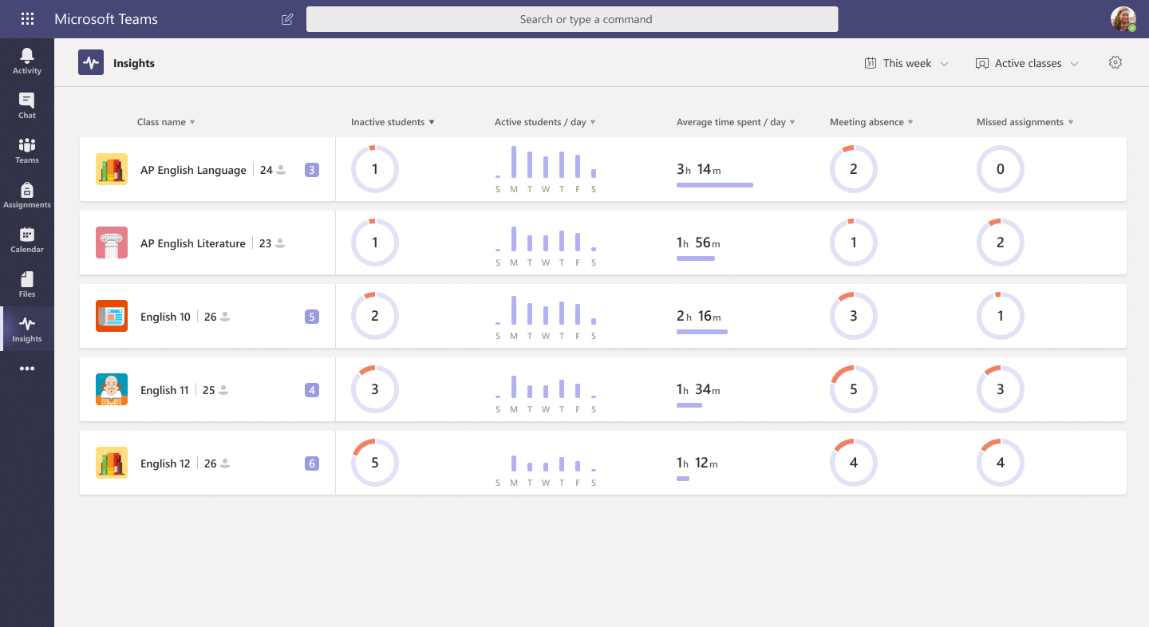
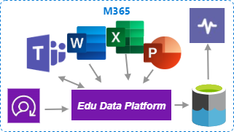

Education Analytics and Insights
Customer’s Azure Subscription
SIS

Slide 12



Data
Engineers
Data
Scientists
Contracted
Data Scientists
Learners,
Educators
School Leaders,
Researchers
Analysts
v0.4
M365
Ingest
Prep & Pseudo-nymize
Transform
& Enrich
Optimize
Build
& Train
Explore
Visualize
Package
& Deliver
Dynamics 365
Dataverse
PowerApps
stage 1
(bronze)
stage 2
(silver)
stage 3
(gold)
SQL serverless
dedicated
SQL pool
Cosmos
data subsets
1) Collect
2) Compute
3) Communicate
Notes:
With Open Education Analytics, we are providing a reference architecture for the Modern Data Estate, and a reference implementation that means you don’t have to build everything yourself. You can:
Provision and govern a modern data estate within your own Azure subscriptions,
Use Synapse studio to facilitate the process of data extraction, ingestion, preparation, transformation, and enrichment
Use Azure Active Directory to enforce role-based-access-control to the data for security and privacy,
Use powerful data visualization tools, such as Power BI, to explore and present data through flexible dashboards
Use modern data science tools, such as Auto ML, that enable high speed research over big data
All built on the foundation of Azure Data Lake storage, which means significant cost efficiencies.

Slide 13
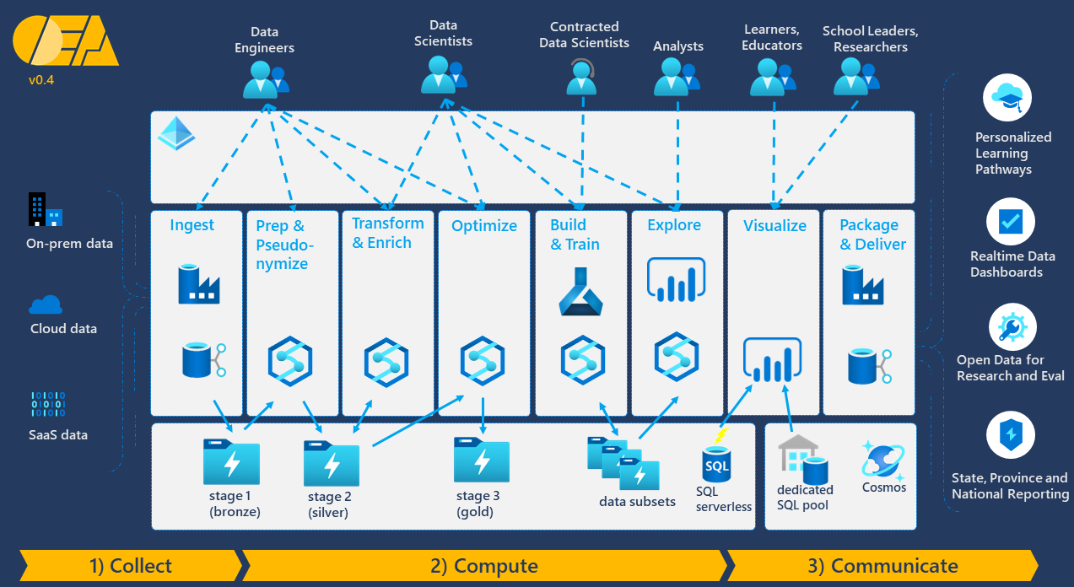
Multi-tenant architecture
Azure Active Directory
ADLS gen2
Azure Active Directory
ADLS gen2

